Slide 1
Advanced Mixed Integer Programming Formulation Techniques MIP Representability
Joey Huchette and Juan Pablo Vielma
Massachusetts Institute of Technology
Spring School of the International Symposium on Combinatorial Optimization (ISCO 2018)
Marrakesh, Morocco, April, 2018

Slide 2
Mixed 0-1 Formulations
Modeling Finite Alternatives = Unions of Polyhedra
Bounded or unbounded polyhedra, but bounded for now

Slide 3

What About Discontinuous Piecewise Linear
Works for piecewise linear functions:
Bounded domain
Lower semicontinuous = closed epigraph
Epigraph is union of unbounded polyhedra

Slide 4
What About Discontinuous Piecewise Linear
Works for piecewise linear functions:
Bounded domain
Lower semicontinuous = closed epigraph
Epigraph is union of unbounded polyhedra

Slide 5
Extended Formulation for Unions of Polyhedra
rational polyhedra and
If
then an ideal formulation for S is

Slide 6
Extended Formulation for PWL Functions
MC Formulation:
S₂
S₃
S₁

Slide 7
Example: Discontinuous Piecewise Linear
≤

Slide 8
Example: Discontinuous Piecewise Linear
Works for piecewise linear functions:
Bounded domain
Lower semicontinuous = closed epigraph

Slide 9

What if Recession Cones are Different?
No linear MIP formulation:
0-1 or general integer
More later

Slide 10

Bounded MIP Representability May be Hidden
Obtaining a MIP formulation may require redundancy

Slide 11
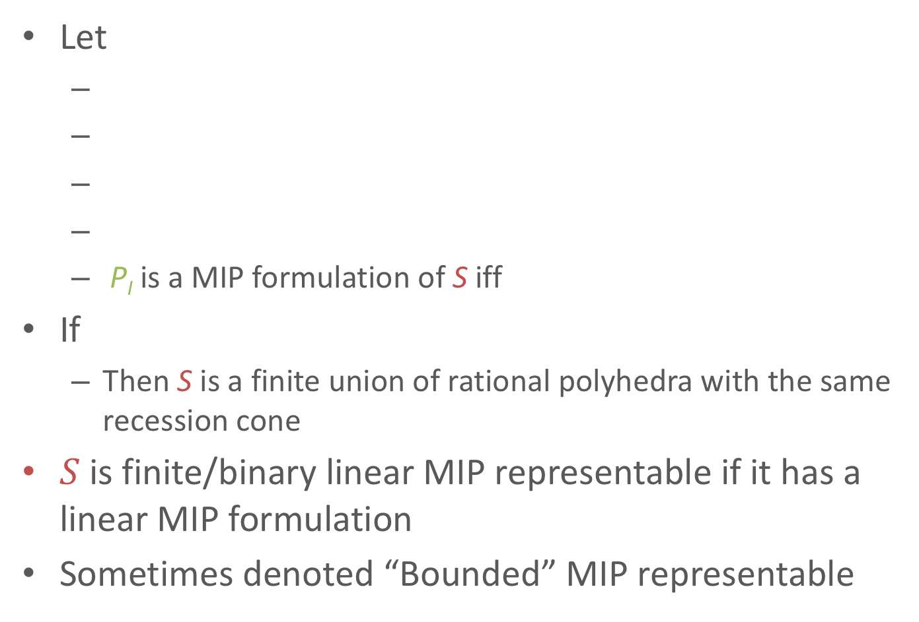
Finite, Binary or 0-1 Linear MIP Representability
Let
P_{I} is a MIP formulation of S iff
If
Then S is a finite union of rational polyhedra with the same recession cone
$S$ is finite/binary linear MIP representable if it has a linear MIP formulation
Sometimes denoted “Bounded” MIP representable

Slide 12
Mixed-Integer Formulations: General Integer

Slide 13
Beyond Unions of Polyhedra
rational polyhedra and
If
then a formulation for S is
Formulation is ideal if

Slide 14
General Linear MIP Representability
rational polyhedra and
If
What about?
MIP formulation:

Slide 15
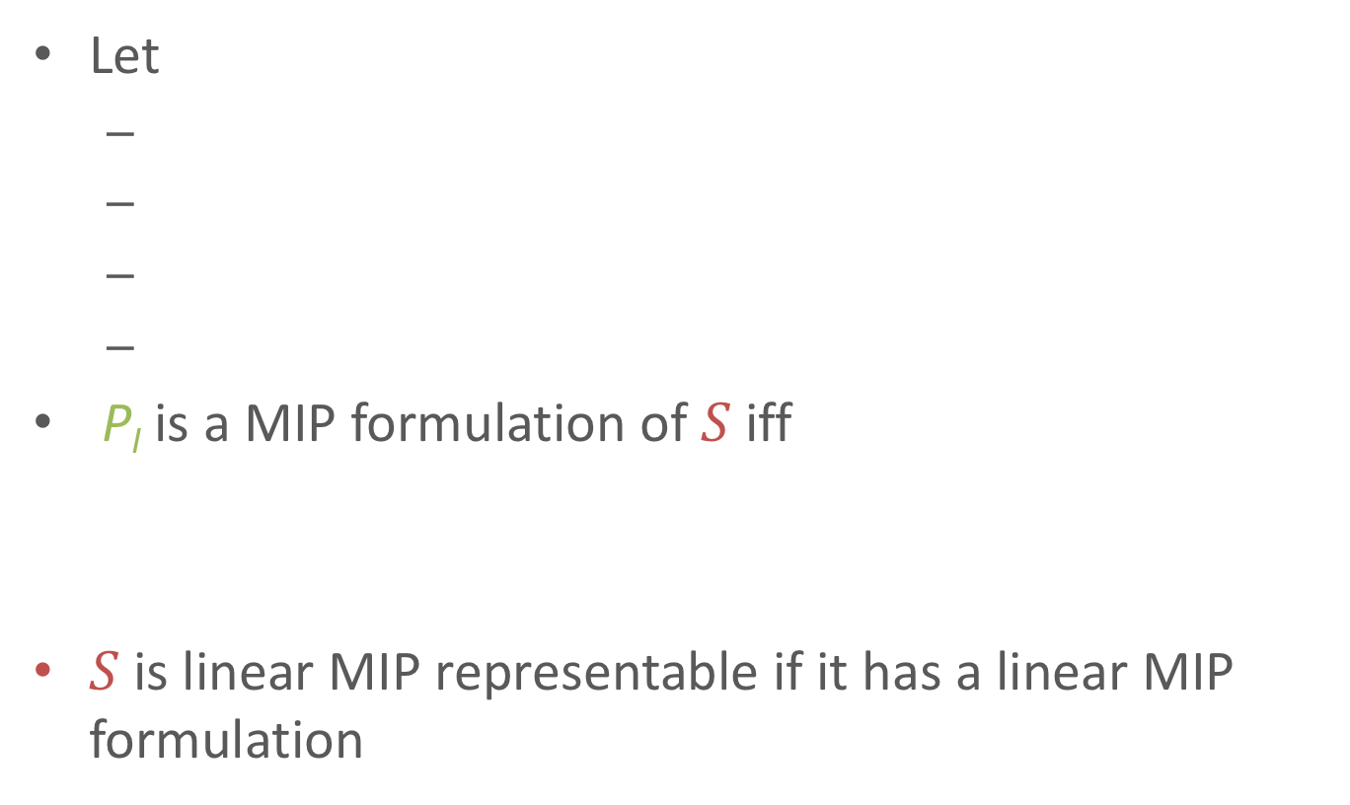
(Linear) Mixed Integer Programming Formulation
Let
P_{I} is a MIP formulation of $S$ iff
$S$ is linear MIP representable if it has a linear MIP formulation

Slide 16
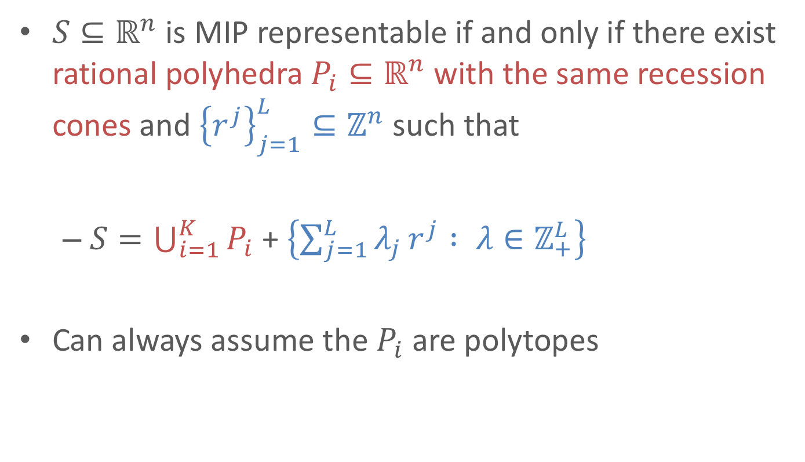
General Linear MIP Representability
$S⊆ℝ^{n}$ is MIP representable if and only if there exist rational polyhedra $P_{i}⊆ℝ^{n}$ with the same recession cones and ${\left\{r^{j}\right\}}_{j=1}^{L}⊆ℤ^{n}$ such that
$S=\bigcup_{i=1}^{K}{P_{i}}$ + $\left\{{\sum_{j=1}^{L}{λ_{j}}r}^{j} : λ∈ℤ_{+}^{L}\right\}$
Can always assume the $P_{i}$ are polytopes

Slide 17
What if Recession Cones are Different?
Not MIP representable: bounded or general
Useful lemma:
If S has a MIP formulation then S is closed and conv(S) is a rational polyhedron

Slide 18
Rational Polyhedral Convex Hull is Not Sufficient
S does not have a MIP formulation

Slide 19
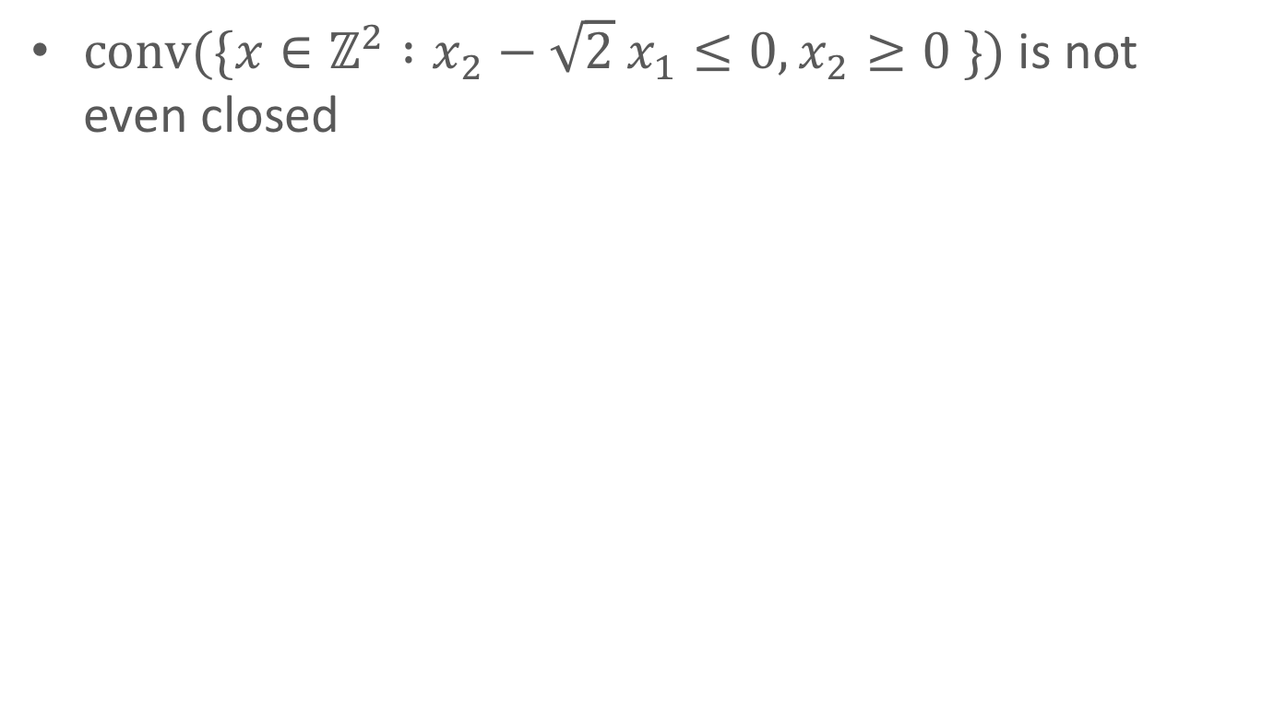
Rationality is Crucial
$conv(\{x∈ℤ^{2} :x_{2}−\sqrt{2} x_{1}≤0, x_{2}≥0 \})⁡$is not even closed

Slide 20
(Convex) MICP Formulations and Representability
A set is MICP representable (MICPR) if it has an MICP formulation:
A closed convex set
auxiliary continuous variables
auxiliary integer variables
or equivalently

Slide 21
What Sets are MICP Representable (MICPR) ?
Two sheet hyperbola?
Spherical shell?
Discrete subsets of the real line or natural numbers:
Dense discrete set?
Set of prime numbers?
"God made the integers, all else is the work of man”
- Leopold Kronecker

Slide 22
A Simple Lemma for non-MICP Representability
Obstruction for MICP representability of S :
Proof: Assume for contradiction there exists M such that:

Slide 23
A Simple Lemma for non-MICP Representability
Obstruction for MICP representability of S :
Spherical shell
Set of prime numbers
Does have non-convex polynomial MIP
Set of Matrices of rank at most k
Piecewise linear interpolation of x² at all integers

Slide 24
MICPR = Convex Sets Indexed by Integers in Convex
3
2
1
0
For rational polyhedral M (Jeroslow and Lowe ’84):
1: Rational polyhedra with
the same recession cone
2: Finite # of shapes
+ periodic translations

Slide 25
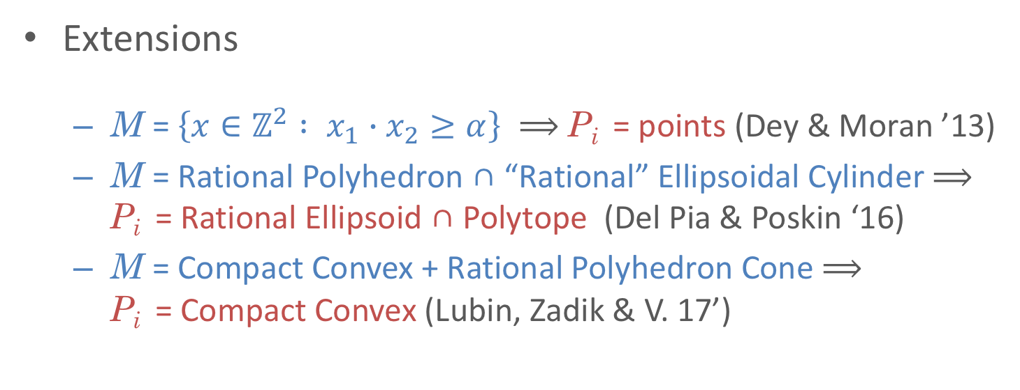
MICPR = Convex Sets Indexed by Integers in Convex
3
2
1
0
Extensions
M = $\left\{x∈ℤ^{2} : x_{1}∙x_{2}≥α\right\} ⟹$ P_{i} = points (Dey & Moran ’13)
M = Rational Polyhedron ∩ “Rational” Ellipsoidal Cylinder $⟹$ P_{i} = Rational Ellipsoid ∩ Polytope (Del Pia & Poskin ‘16)
M = Compact Convex + Rational Polyhedron Cone $⟹$ P_{i} = Compact Convex (Lubin, Zadik & V. 17’)

Slide 26
MICPR = Convex Sets Indexed by Integers in Convex
3
2
1
0
For rational polyhedral M (Jeroslow and Lowe ’84):
1: Rational polyhedra with
the same recession cone
2: Finite # of shapes
+ periodic translations

Slide 27
Extra from MICP 1: Non-Polyhedral Unions
Two sheet hyperbola?
Unions of Non-Polyhedral sets
Plus Projection:
Unions of non-closed sets
Unions of convex sets with different recession cones
✓

Slide 28
Extra from MICP 2: Non-Polyhedral I
An infinite set S is periodic if and only if:
Non-periodic MICPR sets
Dense discrete set
Set of naturals

Slide 29
A Definition Rational MICPR (R-MICPR)
Any rational affine mapping of index set I :
Is bounded, or
Has an integer (rational) recession direction
Irrational directions can hide!
R-MICPR ⇎ and/or = rational space

Slide 30
Properties of Rational MICPR (R-MICPR)
For compact S :
Finite unions of compact convex sets
For S infinite unions of “uniformly bounded” closed convex sets :
Finite union of periodic
Dense discrete and non-periodic naturals NOT R-MICPR
Rational MICP Representability:
Closed under: Finite Union, Cartesian Product and Minkowski sum
NOT Closed under intersection.

Slide 31
R-MICPR: Periodicity for Natural #s
An infinite set of naturals S is periodic if and only if:
It is rational MILP representable
A subset S of the naturals is R-MICPR if and only if:
It is the union of a finite and an infinite periodic set

Slide 32
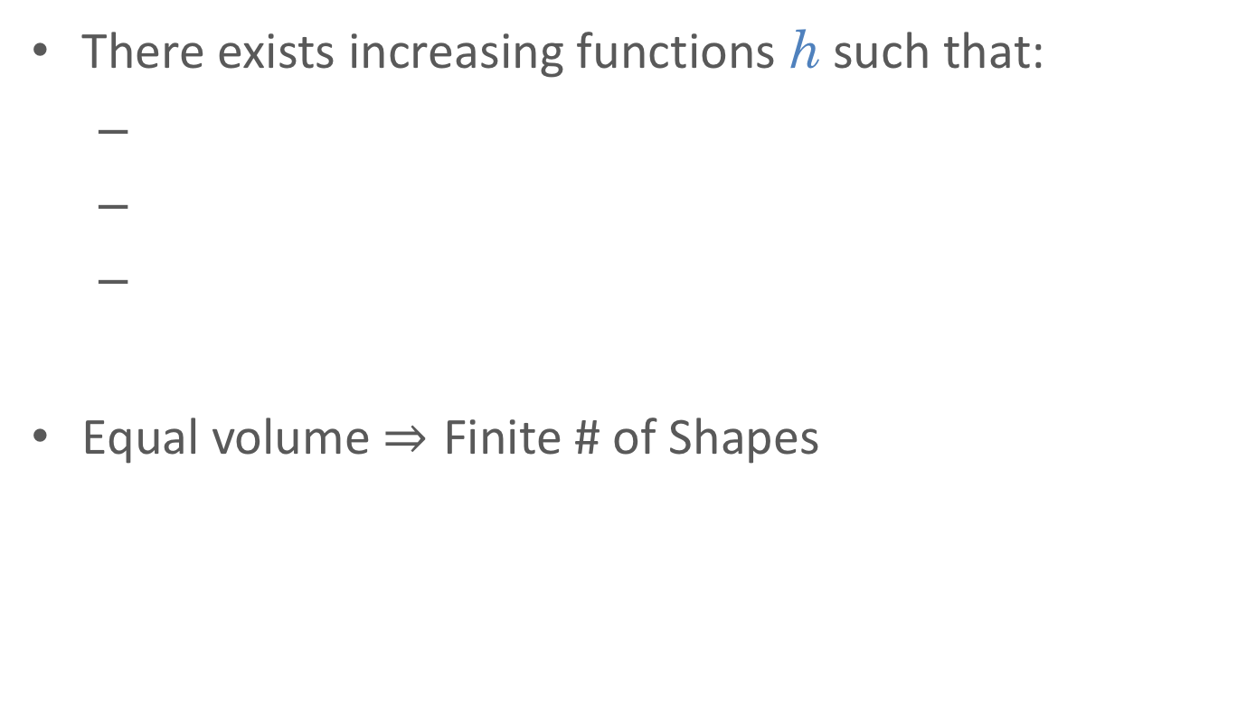
R-MICPR does Not Imply Finite Shapes
h(z)
z
There exists increasing functions h such that:
Equal volume Finite # of Shapes

Slide 35
Polytope

